Slide 1
GP PROGRESS
AI Defects Detection Model

Slide 2
Defects Detection Model

Slide 3
VGG-16 from scratch --failed
Random architecture can’t generalize and get bad results when take new image.
Try to train CNN vgg16 architecture from scratch with different platforms like google colab , jupyter notebook but available resources not enough.

Slide 4
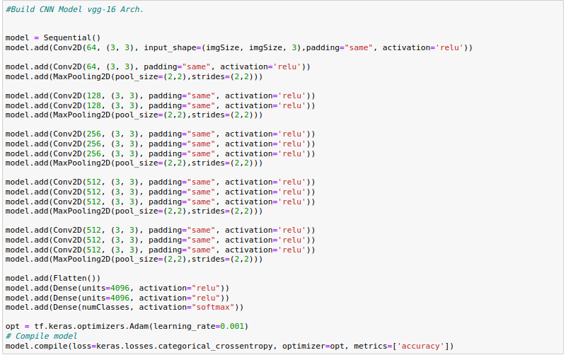
VGG-16 from scratch

Slide 5
Tensorflow.keras Applications
Using weights of Vgg-16 model applied to ImageNet Competition 2014 and get better results in our model and become more generalize and get higher accuracy more than 95%

Slide 6
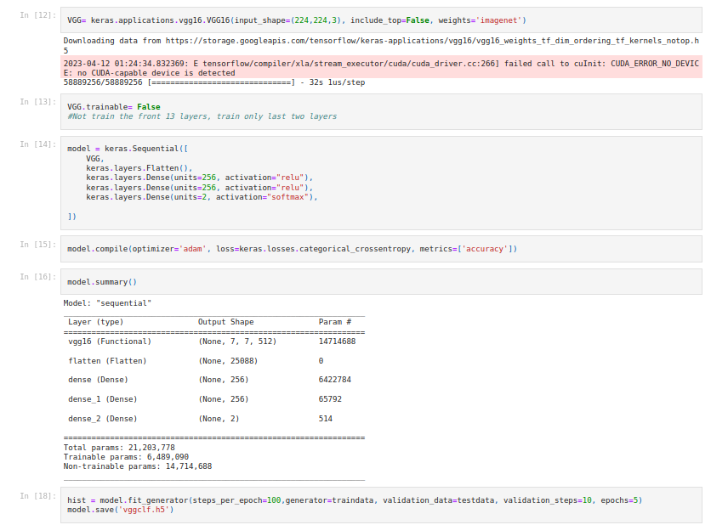
TensorFlow keras VGG-16

Slide 7
Improve the model
Preprocessing, Data Augmentation using ImageDataGenerator in keras to apply some action in our data to track the results of model
{rotate, shift, flip, zoom, resize}
Test different Hyperparameters
{# iterations, activation function, batch size,..}

Slide 8
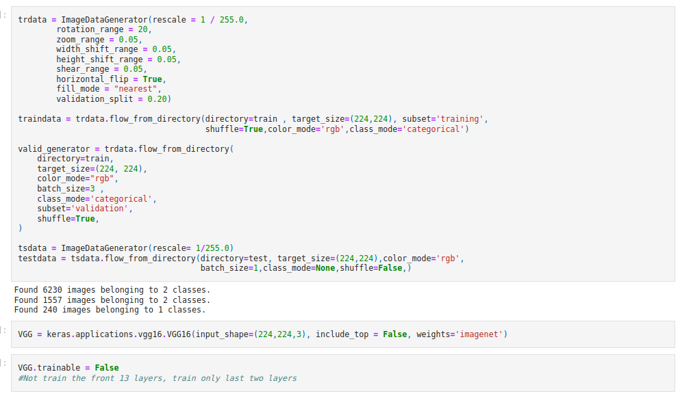
TensorFlow Keras ImageDataGenerator

Slide 9
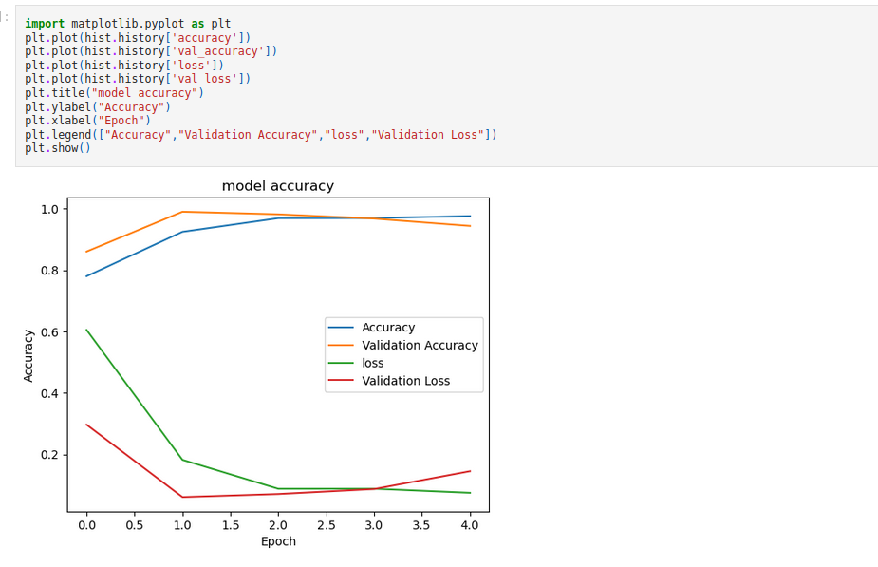

Slide 10
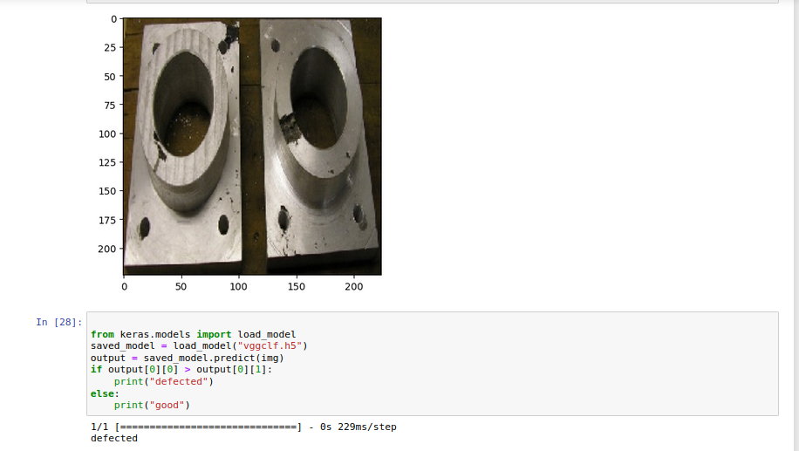
Model Predict a new Image

Slide 11
Object Detection Model

Slide 12
Using SSD Mobnet Model by TensorFlow
We needed to search for a good model which achieve the trade-off between speed and efficiency
SSD (Single Shot Detector) Mobile net models are specifically designated to be lightweight and optimized for Mobiles making it faster and more efficient than many other object detection models.
Despite its lightweight design, SSD Mobilenet can achieve good accuracy in detecting objects in images.
Due to its speed and efficiency, SSD Mobilenet can perform object detection in real-time, making it suitable for applications where real-time processing is important factor in our process.

Slide 13
What about Yolo models ?
Yolo models are better to be used when :
High recall is required: If detecting as many objects as possible is more important than minimizing false positives, YOLO may be a better choice due to its ability to detect many objects in a single pass.
Large object detection: If the task involves detecting large objects in images, YOLO may be a better choice due to its ability to handle large objects more efficiently.
Object tracking: If the task involves tracking objects across multiple frames in a video, YOLO may be a better choice due to its ability to handle object tracking more effectively than SSD Mobilenet.

Slide 14
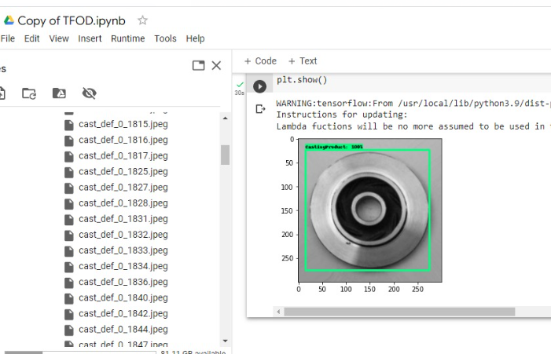
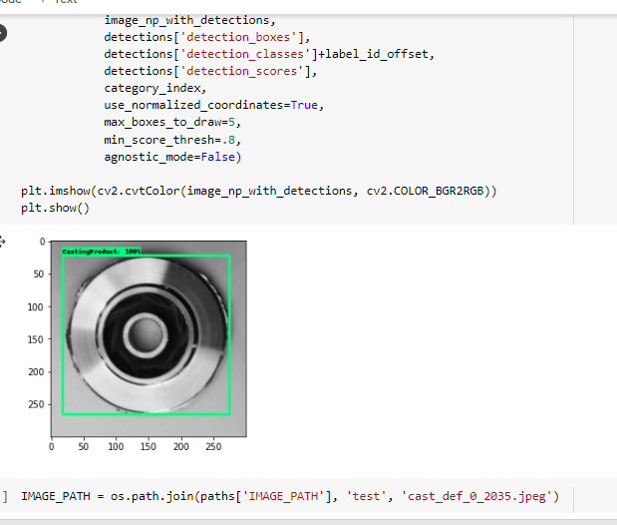
Results by the model
With threshold 0.8
Image dimensions are set to 320x320

Slide 15
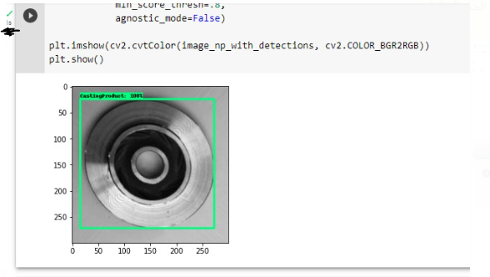
Results by the model

Slide 16
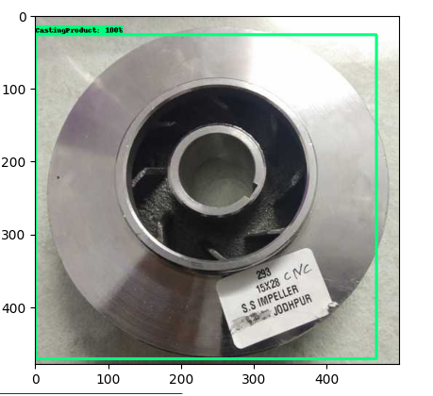
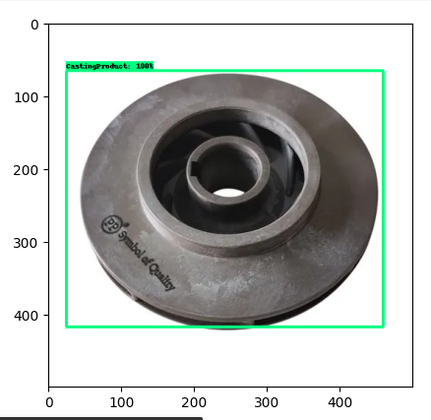
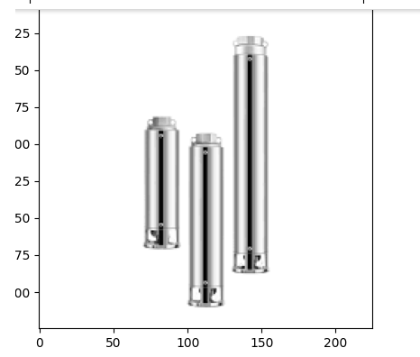
Results with new images to dataset

Slide 17
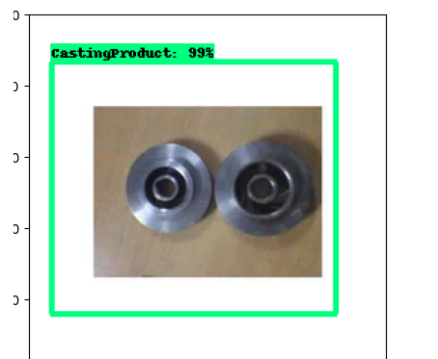
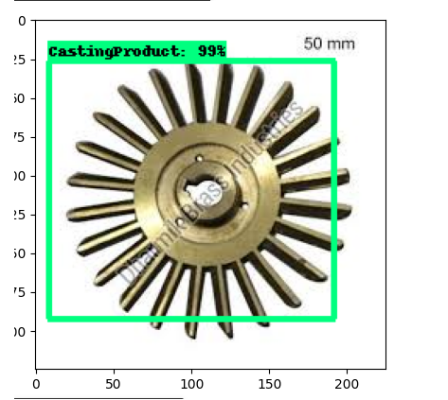
Results with new images to dataset
Other side of the picture:

Slide 18
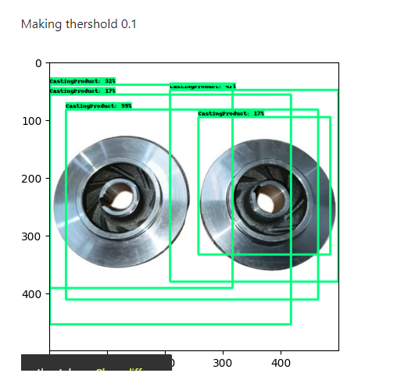
Results with new images to dataset
Making threshold 0.1:

Slide 19
Deploy with
Mobile APP

Slide 20
Flask Server to test our models
Working on UI/UX Design Implementation using flutter
Create flask Server and host on heruku and get predictions with HTTP Protocol request and response with results.
{.tflite get bad predictions and decrease the model accuracy}

Slide 21
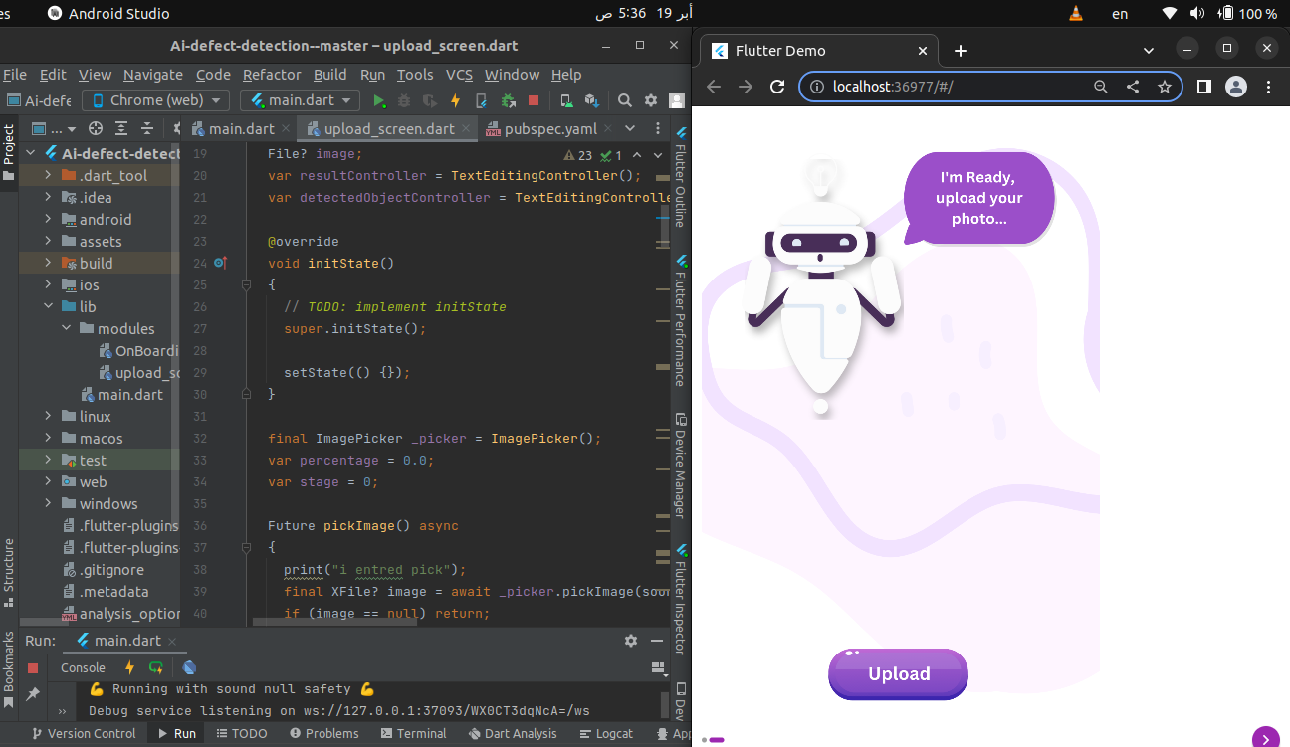
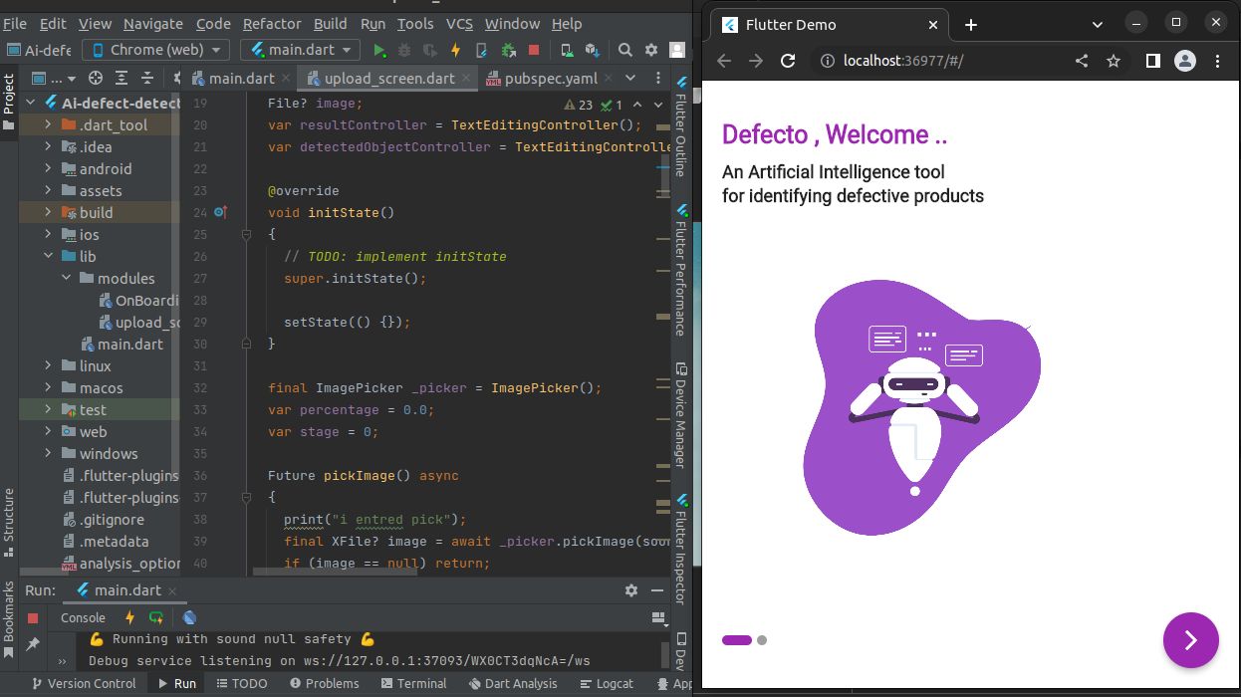
Implementing APP UI using Flutter

Slide 22
What’s Next?
Complete Implementation flutter mobile app
Create Flask Server to load our models
Connect Application with models to get results
Make data augmentation for the data set to retrain models on different angels for the product

Slide 23

Thank you Any Questions?

